Slide 1
LegalEase(App For Onboarding Legal Services)
CSE7101- Capstone Project
Review-4
Batch Number: CSE_160
Under the Supervision of,
Mr. Thatimakula Saikumar – Assistant Professor
Ms. Saiqa Khan - Assistant Professor
School of Computer Science and Engineering
Presidency University
Roll Number | Student Name
20221CSE0090 20221CSE0195 20221CSE0225 | Vishnu. P Vasista. S Dhanush. A
Name of the Program: Computer Science and Engineering
Name of the HoD: Dr.Asif Mohammed , Dr.Blessed Prince
Name of the Program Project Coordinator: Dr.Jayavadivel Ravi , Mr.Muthuraju V
Name of the School Project Coordinators: Dr. Sampath A K , Dr. Geetha A

Slide 2
Content
Github link
Abstract
Literature Survey
Objectives
Algorithms
Proposed method & Feasibility study
User Flow Diagram
Modules
Timeline of the Project
References

Slide 3
Problem Statement Number: PSCS-39
Git-hub Link : https://github.com/vishnu090705/Onboarding-legal-service-providers.git
Category : Software
Abstract :
This project develops a secure Android application for onboarding Legal Service Provider to ensure authenticity and trust. Existing portals fail to provide simplified, accessible, and timely updates, resulting in missed opportunities.
An incentive-based gamification model encourages professional participation, while citizens gain transparent access to verified legal services through a reliable digital marketplace.
The expected outcome is a transparent, secure, and user-friendly eMarketplace that enhances citizen trust, improves access to legal services, and ensures better engagement of professionals. The project also offers real-world exposure to full-stack mobile development, authentication systems, and incentive-based platform design.

Slide 4
Literature Survey
[10] Nyaya Shastra: E-Platform for Legal Providers," IJARSCT, 2024
Link: https://ijarsct.co.in/Paper25646.pdf
[12] Karnale, P.R., Chavan, S.R., Chougale, A.B., Patil, A.A., Jamadar, S.S. (2023), "Incentives based Design for onboarding Legal Service Providers for Extending Legal Services.“
Link: https://www.scribd.com/document/711640084/Incentives-based-Design-for-onboarding-Legal-Service-Providers-for-extending-Legal-Services-to-Citizens-in-India-1
[15]LEGAL SAHYOG HUB: JETIR2406832, "Incentives Based Design For Onboarding Legal Service Providers.”
Link: https://www.jetir.org/view?paper=JETIR2406832
[18]Legal Bharat Incentive, Legalbharat
Link : https://www.scribd.com/document/875148548/Legal-Bharat-Incentive

Slide 5
Objectives
Develop a secure Android application that enables Legal Service Providers (LSPs) such as advocates, notaries, and mediators to onboard digitally with proper authentication.
Ensure transparency and accessibility by providing real-time updates on service requests, provider availability, and feedback.
Design and implement an incentive-based system (badges, rewards, rankings) that motivates legal professionals to actively participate and maintain service quality.
Provide citizens with a user-friendly interface to search, filter, and connect with verified legal service providers, while allowing admins to monitor onboarding and approvals.

Slide 6
Algorithms
Resource Allocation (Avoid Double-Booking)
Reliable booking engine—no overlapping bookings, respect working hours, support recurring slots.
Concepts used:
Array List / Hash Maps
How it works:
Maintain an interval tree (or segment tree) of booked slots per provider.
To check availability, search for any overlapping intervals. Insert/delete in log time.
Why We Use:
Prevents double-booking of providers
Ensures trust - citizens won’t see providers cancel due to conflicts.

Slide 7
Proposed method & Feasibility study
Proposed Method:
The proposed solution is the “LegalEase" Progressive App. Its innovation lies in its integrated, accessible, and user-centric design:
Incentive-Based Engagement System Gamification features such as badges, points, and rankings to motivate professionals.
Cloud-Backed Storage and APIsFirebase / AWS S3 for secure document and image storage.
Technical Feasibility: The system can be implemented using widely available technologies like Android Studio (Java) for mobile development, Firebase/AWS for secure storage.
Economic Feasibility: Deployment on cloud services can be scaled as needed, ensuring cost-effectiveness for prototype and real-world usage.

Slide 8
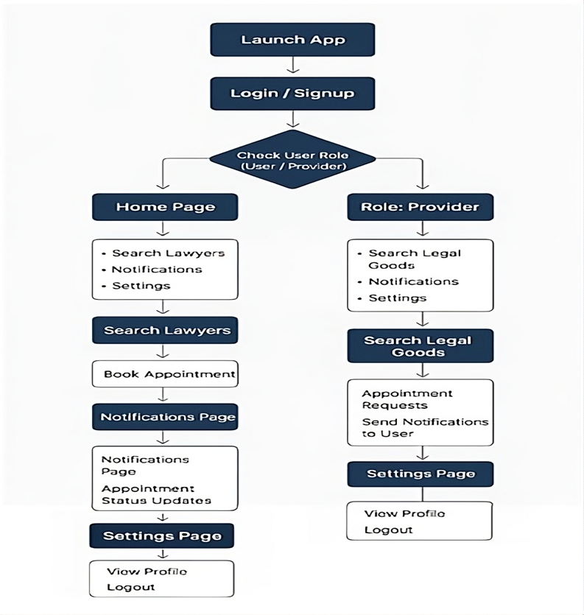
Flow Diagram

Slide 9
Flow Diagram continue….
The User Flow Diagram illustrates the interaction between different stakeholders of the E-Marketplace for Legal Services platform. It explains how both citizens (users) and legal service providers (lawyers/advocates) navigate through the application.
1. Entry Point
Launch App: User opens the mobile or web application.
Login / Signup: User authenticates or creates a new account.
2. Role Determination
Check User Role (User / Provider): App identifies whether the user is a regular user or a service provider.

Slide 10
Flow Diagram continue…….
User Role Flow:
Home Page: Central hub for accessing features like search, notifications, and settings.
  Search Lawyers: Allows users to find legal professionals.
    Book Appointment: Users can schedule meetings with selected lawyers.
  Notifications: Displays updates related to appointments and interactions.
    Appointment Status Updates: Shows confirmation, cancellation, or changes.
  Settings: Lets users manage their account preferences.
    View Profile: Displays user details and account info.
    Logout: Ends the session and returns to login.

Slide 11
Flow Diagram continue…….
Provider Role Flow:
Home Page: Providers access tools to manage services and user interactions.
  Search Legal Goods: Enables providers to browse or manage legal products or services.
    Appointment Requests: View and respond to user appointment bookings.
    Send Notifications to User: Notify users about updates or confirmations.
  Notifications: Shows provider-specific alerts and updates.
  Settings: Manage provider account and preferences.
    View Profile: Displays provider's professional details.
    Logout: Ends provider session and returns to login.

Slide 12
Flow Diagram continue…….
Libraries and APIs
Google Firebase SDK (Authentication + Firestore)
AndroidX libraries (AppCompat, Material Components, ConstraintLayout, RecyclerView, etc.)
Play Services (Google APIs) if you later add location-based lawyer search
Key Components:
Authentication Service: Manages user logins.
Cloud Hosting: The entire application is deployed on a cloud provider for reliability and scalability.

Slide 13
Modules
Incentive & Gamification Module : Provides rewards such as badges, points, certificates, and higher visibility for verified LSPs.
Citizen Service Access Module : Enables citizens to search, filter, and view verified LSP profiles.
Cloud Storage & API Module : Uses Firebase Storage / AWS S3 to store documents.

Slide 14
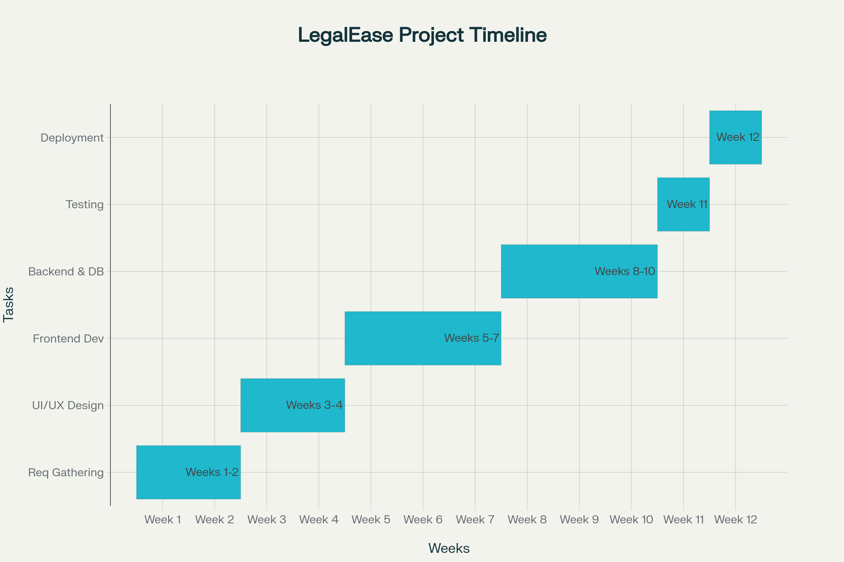
Timeline

Slide 15
References
[1]. [Sharetribe], "How to build a marketplace for legal services," 2023.sharetribe
[2]. Itexus, "Legal Marketplace Development: Guide," 2023.itexus
[3]. "LegalTech in India – Role of Technology and Legal Education," Taxmann, 2025.taxmann
[4]. Infosys, "How a Digital Transformation Enhances the Extended Legal ...," Infosys.com, 2024.infosys
[5]. "Alternative legal service providers muscle in," Law.asia, 2025.
[6]. "Top 11 ODR Service Providers in India," Online Legal India, 2025.onlinelegalindia
[7]. Indian Journal of Law and Technology (IJLT), Vol. 20, Issue 1 (2022).
[8]."Impact of Digital Legal Services on Traditional Law Practice in India," ICISIT,2024.iciset
[9]. "Startups as disruptors of legal tech in India," Daksh, 2020.dakshindia
[10]. "Nyaya Shastra: E-Platform for Legal Providers," IJARSCT, 2024.ijarsct
[11]. Legal Kart, "The Rise of Online Lawyer Consultation," LegalKart.com, 2025.

Slide 16
References continue…
[12]. Karnale, P.R., Chavan, S.R., Chougale, A.B., Patil, A.A., Jamadar, S.S. (2023), "Incentives based Design for onboarding Legal Service Providers in India," IJSREM.scribd
[13]. "Legal Tech Startups in India," PrivateCircle, 2025.
[14]. "Online Dispute Resolution Service Providers in India," 2025.
[15]. LEGAL SAHYOG HUB: JETIR2406832, "Incentives Based Design For Onboarding
Legal Service Providers," JETIR.org.jetir
[16]. "Exploring the Significance of Onboarding Process in Higher Education," JETIR.org, 2023.jetir
[17]. Phenom, "The Importance of Onboarding and How to Get It Right," 2025.phenom
[18]. Legal Bharat Incentive, Legalbharat, 2025.scribd
[19]. LawRato, Platform Overview.privatecircle
[20]. Legal Service India, Platform Overview.scribd
[21]. Gupta, S., "Commercial Disputes and Technology," 2021.taxmann
[22]. Legal Connect, Platform Overview.scribd

Slide 17
Conclusion
This application successfully bridges the gap between citizens and legal service providers.
Reviews and feedback ensure transparency and trust in the system.
Incentive-based design motivates provider to deliver quality service.
This application lays a strong foundation for scalable and reliable legal marketplace.
Future Work :
Implement rating & review analytics (average rating, top providers).
Add push notifications using Firebase Cloud Messaging.

Slide 18


